Slide 1
Agile Modeling and Prototyping
6
Systems Analysis and Design
Kendall & Kendall
© 2008 Pearson Prentice Hall

Slide 2
Learning Objectives
Understand the roots of agile modeling in prototyping and the four main types of prototyping
Be able to use prototyping for human information requirements gathering
Understand the concept of RAD for use in human information requirements gathering and interface design
Understand agile modeling and the core practices that differentiate it from other development methodologies
Learn the importance of values critical to agile modeling
Understand how to improve efficiency for users who are knowledge workers using either structured methods or agile modeling
Kendall & Kendall
6-<number>

Slide 3
Major Topics
Prototyping
Rapid application development (RAD)
Agile Modeling
Kendall & Kendall
6-<number>

Slide 4
Prototyping
Patched-up
Nonoperational
First-of-a-series
Selected features
Kendall & Kendall
6-<number>
Notes:
Information gathered in the prototyping phase allows the analyst to set priorities and redirect plans inexpensively, with a minimum of disruption.

Slide 5
Patched-Up Prototype
A system that works but is patched up or patched together
A working model that has all the features but is inefficient
Users can interact with the system
Retrieval and storage of information may be inefficient
Kendall & Kendall
6-<number>
Notes:
In engineering this approach is referred to as breadboarding.
Users can interact with the system – getting accustomed to the interface and types of output available.
Retrieval and Storage of information may be inefficient – programs were written rapidly with the objective of being workable rather than efficient.

Slide 6
Nonoperational Scale Models
A nonworking scale mode that is set up to test certain aspects of the design
A nonworking scale model of an information system might be produced when the coding required by the application is too expensive to prototype but when a useful idea of the system can be gained through prototyping of the input and output only
Kendall & Kendall
6-<number>
Notes:
A nonworking scale model of an information system –
processing because of undue cost and time, would not be prototyped.
users can make decisions based on their use of prototyped input and output.

Slide 7
First-of-a-Series Prototype
Creating a pilot
Prototype is completely operational
Useful when many installations of the same information system are planned
A full-scale prototype is installed in one or two locations first, and if successful, duplicates are installed at all locations based on customer usage patterns and other key factors
Kendall & Kendall
6-<number>
Notes:
Pilot – a first full-scale model of a system.
Creation of a working model is one of the types of prototyping done with RAD.

Slide 8
Selected Features Prototype
Building an operational model that includes some, but not all, of the features that the final system will have
Some, but not all, essential features are included
Built in modules
Part of the actual system
Kendall & Kendall
6-<number>
Notes:
Some, but not all, essential features are included – a menu on a screen that lists six features may only have three available.
Built in modules – if the features that are prototyped are evaluated by users as successful, they can be incorporated into the larger, final system without undertaking immense work in interfacing.
Part of the actual system – not just a mock-up.

Slide 9
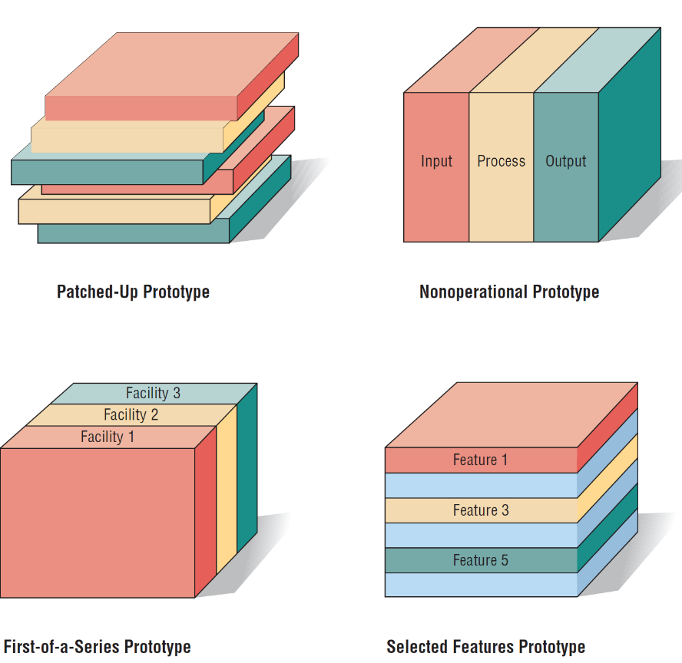
Figure 6.1 Four kinds of prototypes (clockwise, starting from the upper left)
Kendall & Kendall
6-<number>

Slide 10
Prototyping as an Alternative to the Systems Life Cycle
Two main problems with the SDLC
  Extended time required to go through the development life cycle
  User requirements change over time
Rather than using prototyping to replace the SDLC use prototyping as a part of the SDLC
Kendall & Kendall
6-<number>
Notes:
SDLC – a logical, systematic approach to follow in the development of information systems.
Rather than using prototyping to replace the SDLC use prototyping as a part of the SDLC –
Advantages –
effectively shortens the time between ascertainment of human information requirements and delivery of a workable system.
overcomes some of the problems of accurately identifying user information requirements.
Disadvantages –
prematurely shaping a system before the problem or opportunity being addressed is thoroughly understood.
may result in producing a system that is accepted by specific groups of users but that is inadequate for overall system needs.

Slide 11
Prototyping with SDLC Advantages
Advantages –
  Effectively shortens the time between ascertainment of human information requirements and delivery of a workable system.
  Overcomes some of the problems of accurately identifying user information requirements.
Kendall & Kendall
6-<number>
Notes:
SDLC – a logical, systematic approach to follow in the development of information systems.
Rather than using prototyping to replace the SDLC use prototyping as a part of the SDLC –
Advantages –
effectively shortens the time between ascertainment of human information requirements and delivery of a workable system.
overcomes some of the problems of accurately identifying user information requirements.
Disadvantages –
prematurely shaping a system before the problem or opportunity being addressed is thoroughly understood.
may result in producing a system that is accepted by specific groups of users but that is inadequate for overall system needs.

Slide 12
Prototyping with SDLC Disadvantages
Disadvantages –
  Prematurely shaping a system before the problem or opportunity being addressed is thoroughly understood.
  May result in producing a system that is accepted by specific groups of users but that is inadequate for overall system needs.
Kendall & Kendall
6-<number>
Notes:
SDLC – a logical, systematic approach to follow in the development of information systems.
Rather than using prototyping to replace the SDLC use prototyping as a part of the SDLC –
Advantages –
effectively shortens the time between ascertainment of human information requirements and delivery of a workable system.
overcomes some of the problems of accurately identifying user information requirements.
Disadvantages –
prematurely shaping a system before the problem or opportunity being addressed is thoroughly understood.
may result in producing a system that is accepted by specific groups of users but that is inadequate for overall system needs.

Slide 13
Guidelines for Developing a Prototype
Work in manageable modules
Build the prototype rapidly
Modify the prototype in successive iterations
Stress the user interface
Kendall & Kendall
6-<number>
Notes:
Prototyping is a superb way to elicit feedback about the proposed system and about how readily it is fulfilling the information needs of its users.
The first step of prototyping is to estimate the costs involved in building a module of the system.
Work in manageable modules - a manageable module is one that allows users to interact with its key features but can be built separately from other system modules.
Build the prototype rapidly - putting together an operational prototype both rapidly and early in the SDLC allows the analyst to gain valuable insight into how the remainder of the project should go.
Modify the prototype - creating it in modules that are not highly interdependent.
Stress the user interface - for many users the interface is the system.

Slide 14
Disadvantages of Prototyping
It can be difficult to manage prototyping in larger systems
Users and analysts may adopt a prototype as a completed system
Kendall & Kendall
6-<number>
Notes:
users and analysts may adopt a prototype as a completed system - when it is in fact inadequate and was never intended to serve as a finished system.

Slide 15
Advantages of Prototyping
Potential for changing the system early in its development
Opportunity to stop development on a system that is not working
Possibility of developing a system that more closely addresses users’ needs and expectations
Kendall & Kendall
6-<number>
Notes:
Successful prototyping depends on early and frequent user feedback, which analysts can use to modify the system and make it more responsive to actual needs.

Slide 16
RAD (Rapid Application Development)
An object-oriented approach to systems development that includes a method of development as well as software tools
Kendall & Kendall
6-<number>
Notes:
Can be thought of as a specific implementation of prototyping.

Slide 17
RAD Phases
Requirements planning
RAD design workshop
Implementation
Kendall & Kendall
6-<number>

Slide 18
Requirements Planning Phase
Users and analysts meet to identify objectives of the application or system
Orientation is toward solving business problems
Kendall & Kendall
6-<number>
Notes:
Users and analysts meet to identify objectives of the application or system – and to identify information requirements arising from those objectives.
Orientation is toward solving business problems – the focus will always remain on reaching business goals.

Slide 19
RAD Design Workshop
Design and refine phase
Use group decision support systems room if available
Users respond to actual working prototypes
Analysts refine designed modules based on user responses
Kendall & Kendall
6-<number>
Notes:
Design and refine phase – can best be characterized as a workshop.
The workshop format is very exciting and stimulating, and if experienced users and analysts are present, there is no question that this creative endeavor can propel development forward at an accelerated rate.

Slide 20
Implementation Phase
As the systems are built and refined, the new systems or part of systems are tested and then introduced to the organization
When creating new systems, there is no need to run old systems in parallel
Kendall & Kendall
6-<number>
Notes:
When creating new systems, there is no need to run old systems in parallel - there is no old system, there is often no need to (and no real way to) run the old and new systems in parallel before implementation.

Slide 21
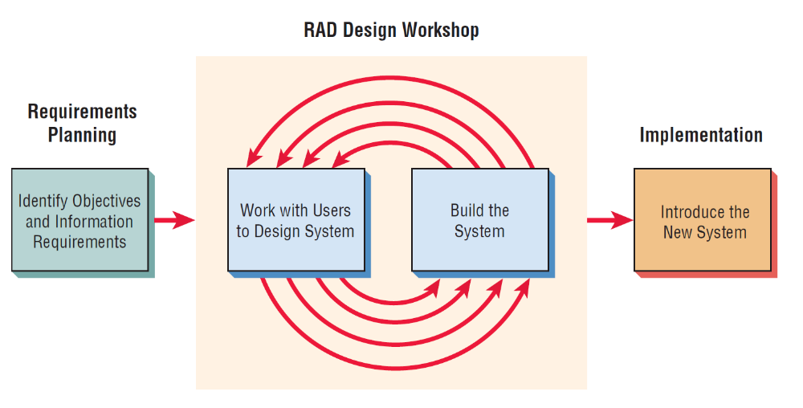
Figure 6.4 The RAD design workshop is the heart of the interactive development process
Kendall & Kendall
6-<number>
Notes:
Notice that RAD involves users in each part of the development effort, with intense participation in the business part of the design.

Slide 22
Comparing RAD to the SDLC
RAD software tools are used to generate screens and exhibit the overall flow of the running of the application
RAD users are signing off on a visual model representation
RAD implementation is less stressful because users have helped to design the business aspects of the system
Kendall & Kendall
6-<number>
Notes:
The ultimate purpose of RAD is to shorten the SDLC and in this way respond more rapidly to dynamic information requirements of organizations.

Slide 23
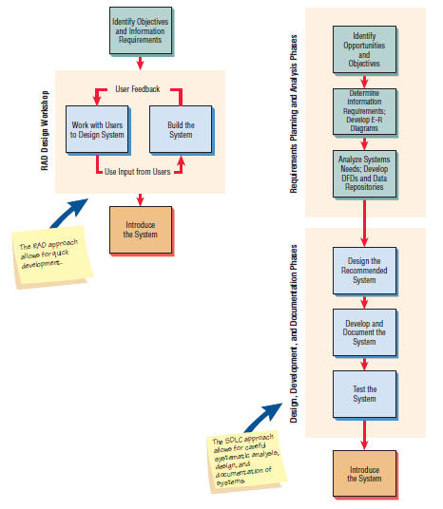
Figure 6.6 The RAD design workshop and the SDLC approach compared
Kendall & Kendall
6-<number>

Slide 24
When to Use RAD
The team includes programmers and analysts who are experienced with it
There are pressing reasons for speeding up application development
The project involves a novel ecommerce application and needs quick results
Users are sophisticated and highly engaged with the goals of the company
Kendall & Kendall
6-<number>
Notes:
As an analyst, you want to learn as many approaches and tools as possible to facilitate getting your work done in the most appropriate way.

Slide 25
Disadvantages of RAD
Trying to hurry the project too much
Lack of documentation
Waste of resource
Kendall & Kendall
6-<number>
Notes:
Example – building a storage shed.

Slide 26
Agile Modeling
Agile methods are a collection of innovative, user-centered approaches to systems development
Tries to define an overall system plan quickly, develop and release software quickly, and then continuously revise the software to add additional features
Kendall & Kendall
6-<number>

Slide 27
Values and Motivation for Agile Modeling
Communication
Simplicity
Feedback
Courage
Kendall & Kendall
6-<number>
Notes:
Agile modelers possess the self-confidence to allow their customers to question, critique, and sometimes complain about the system under development. Analysts learn from their customers, who have been in business a long time.

Slide 28
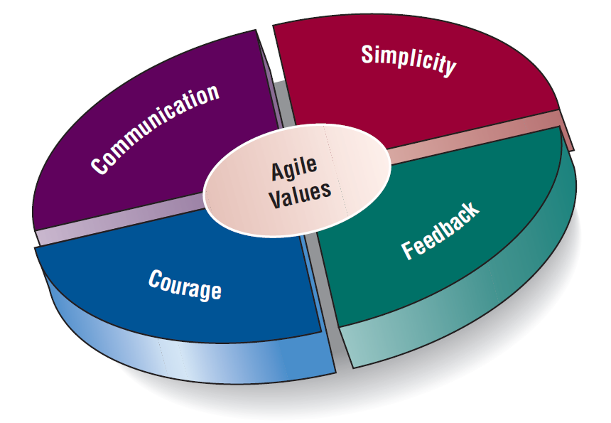
Figure 6.7 Values are crucial to the agile approach
Kendall & Kendall
6-<number>

Slide 29
The Basic Principles of Agile Modeling
Providing rapid feedback
Assuming simplicity
Changing incrementally
Embracing change
Encouraging quality work
Kendall & Kendall
6-<number>
Notes:
Providing rapid feedback – quick and correct comments on implemented s/w or prototype based on the bug/errors/quality
Assuming simplicity - over 90 percent of problems can be solved with utter simplicity.
Changing incrementally - you are constantly making the smallest change possible that still results in a difference in the development effort.
Embracing change - we want to keep all of our options open, but we want to be able to simultaneously solve whatever presents the biggest obstacle.
Encouraging quality work - all participants want to do quality work.

Slide 30
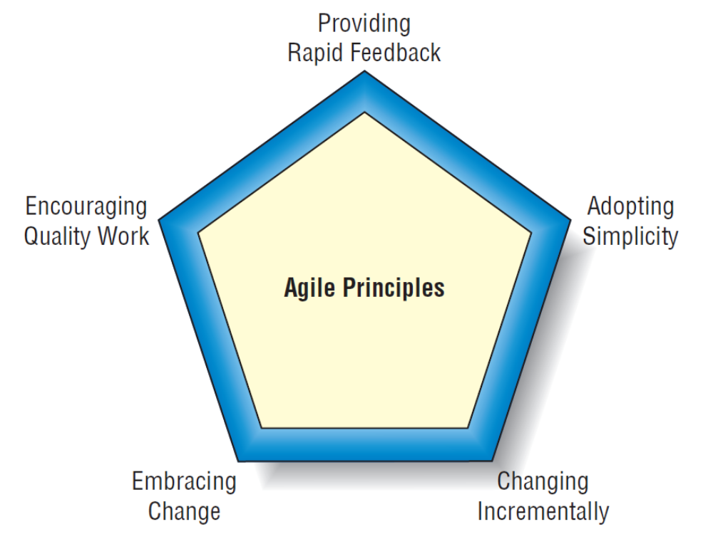
Figure 6.8 Five Agile Principles guide the systems analyst through a successful project
Kendall & Kendall
6-<number>

Slide 31
Activities of Agile Modeling
Activities:
  Coding
  Testing
  Listening
  Designing
Kendall & Kendall
6-<number>
Notes:
The agile analyst needs to identify the amount of effort that will go into each activity and balance that with the resources needed to complete the project.
Coding - the most valuable thing that we receive from code is “learning.”
Testing - the agile approach views automated tests as critical.
Listening - in the agile approach, listening is done in the extreme.
Designing - a way of creating a structure to organize all of the logic in the system.

Slide 32
Four Resource Control Variables of Agile Modeling
Time
Cost
Quality
Scope
Kendall & Kendall
6-<number>
Notes:
When these four control variables are properly included in the planning, there is a state of balance between the resources and the activities needed to complete the project.

Slide 33
Four Core Agile Practices
Short releases
40-hour work week
Onsite customer
Pair programming
Kendall & Kendall
6-<number>
Notes:
Short releases - the development team compresses the time between releases of their product.
40-hour work week - agile development teams purposely endorse
a cultural core practice in which the team works intensely together during a typical 40-hour work week.
Onsite customer - a user who is an expert in the business aspect of the systems development work is onsite during the development process.
Pair programming - you work with another programmer of your own choosing.

Slide 34
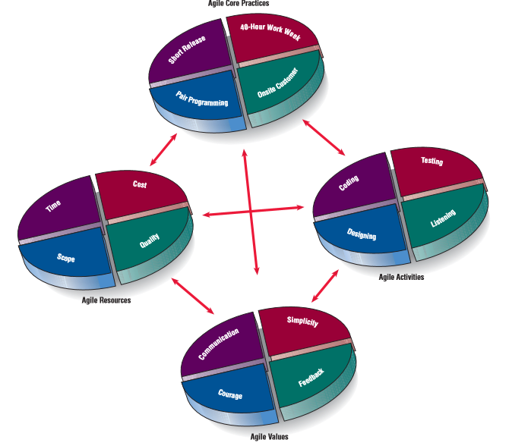
Figure 6.9 The core practices are interrelated with agile modeling’s resources, activities, and values
Kendall & Kendall
6-<number>

Slide 35
The Agile Development Process
Listen for user stories from the customer
Draw a logical workflow model to gain an appreciation for the business decisions represented in the user story
Create new user stories based on the logical model
Develop some display prototypes
Using feedback from the prototypes and the logical workflow diagrams, develop the system
Kendall & Kendall
6-<number>

Slide 36
Writing User Stories
Display alternative flights
    Prepare a list of the five cheapest flights.
Offer cheaper alternatives
    Suggest to customers that they travel on other days, make weekend stays, take special promotions, or use alternate airports.
Purchase a ticket
    Allow the customer to purchase a ticket directly using a credit card (check validity).
    Allow the customer to choose his or her seat
    Direct the customer to a visual display of the airplane and ask the customer to select a seat.
Kendall & Kendall
6-<number>
Notes:
User stories serve as reminders to the developers that they must hold conversations devoted to those requirements.

Slide 37
Scrum
Product backlog
Sprint backlog
Sprint
Daily scrum
Demo
Kendall & Kendall
6-<number>
Notes:
Scrum is a high-intensity methodology. It is just one of the approaches that adopts the philosophy of agile modeling.
Product backlog - in which a list is derived from product specifications.
Sprint backlog - a dynamically changing list of tasks to be completed in the next sprint.
Sprint - a 30-day period in which the development team transforms the backlog into software that can be demonstrated.
Daily scrum - a brief meeting in which communication is the number-one rule.
Demo - working software that can be demonstrated to the customer.

Slide 38
Comparing Agile Modeling and Structured Methods
Improving the efficiency of systems development
Risks inherent in organizational innovation
Kendall & Kendall
6-<number>
Notes:
Efficiency - seven strategies that can improve the efficiency of knowledge work.
Risks – when is the appropriate time to upgrade human skills, adopt new organizational processes, and institute internal change.

Slide 39
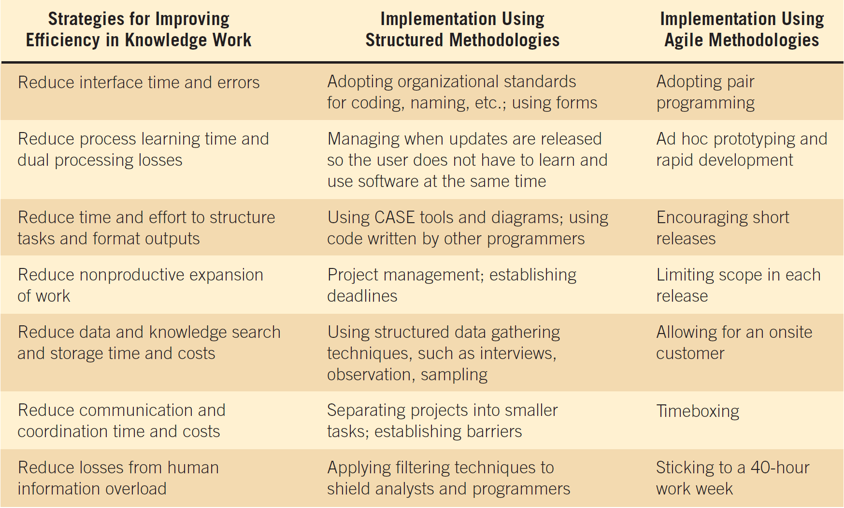
Figure 6.12 How Davis and Naumann’s (1999) strategies for improving efficiency can be implemented using two different development approaches
Kendall & Kendall
6-<number>

